Slide 1





Introduction To Python Programming

Slide 2

Hello!
I am Eslam Ahmed
I am a software engineer.
You can find me at jeksogsa@gmail.com

Slide 3

Hello!
I am Eman Ehab
I am a ML research engineer.
You can find me at emanehab.ieee@gmail.com

Slide 4
Introduction to Python programming Course Outline
Intro to Computer Science
Environment Setup (Anaconda)
Command Line
Conda & pip package managers
Jupyter Notebook
Input & Output
Variables
Data types
Numbers & Math
Boolean & Comparison and Logic
Strings
Lists
Tuples
Sets
Dictionaries
File Handling
If Conditions
For Loops
Built-in functions & Operators (zip, enumerate, range, …)
List Comprehensions
Functions
Lambda Expressions
Map, Filter, Reduce
Variables Scope
Modules & Packages

Slide 5
Introduction to Python programming Course Outline
Intro to Computer Science
Environment Setup (Anaconda)
Command Line
Conda & pip package managers
Jupyter Notebook
Input & Output
Variables
Data types
Numbers & Math
Boolean & Comparison and Logic
Strings
Lists
Tuples
Sets
Dictionaries
File Handling
If Conditions
For Loops
Built-in functions & Operators (zip, enumerate, range, …)
List Comprehensions
Functions
Lambda Expressions
Map, Filter, Reduce
Variables Scope
Modules & Packages

Slide 6
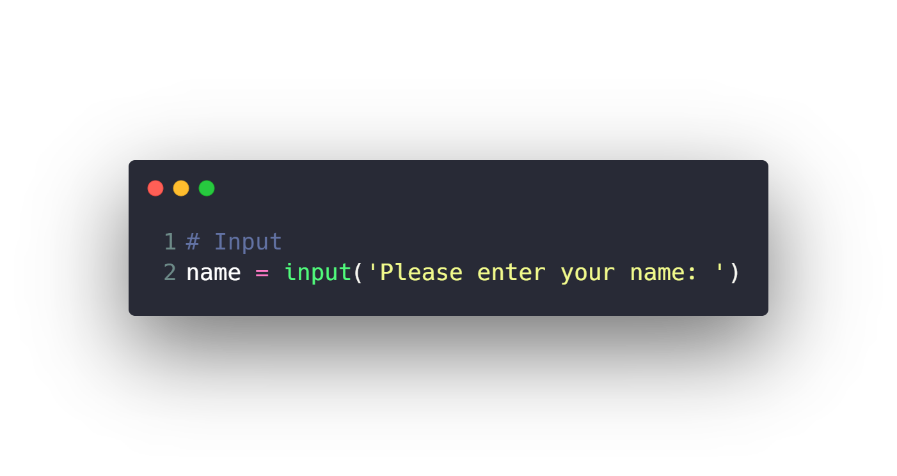


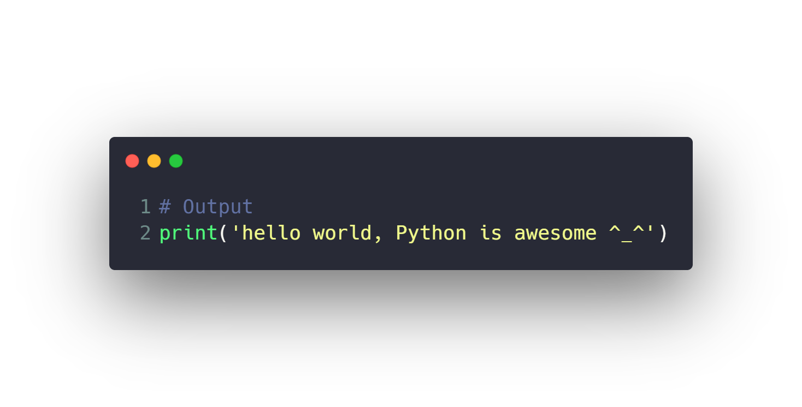

Input & Output

Slide 7
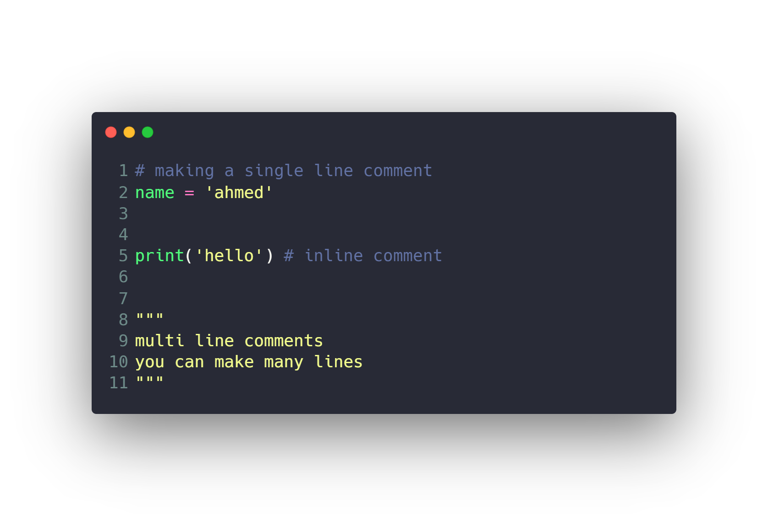
Input & Output
Comments

Slide 8
Introduction to Python programming Course Outline
Intro to Computer Science
Environment Setup (Anaconda)
Command Line
Conda & pip package managers
Jupyter Notebook
Input & Output
Variables
Data types
Numbers & Math
Boolean & Comparison and Logic
Strings
Lists
Tuples
Sets
Dictionaries
File Handling
If Conditions
For Loops
Built-in functions & Operators (zip, enumerate, range, …)
List Comprehensions
Functions
Lambda Expressions
Map, Filter, Reduce
Variables Scope
Modules & Packages

Slide 9
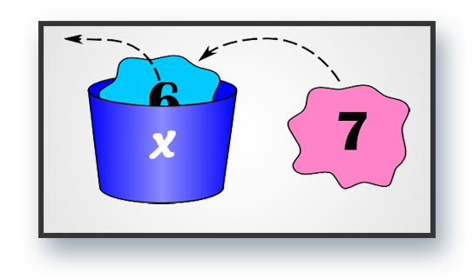
Variables

Slide 10
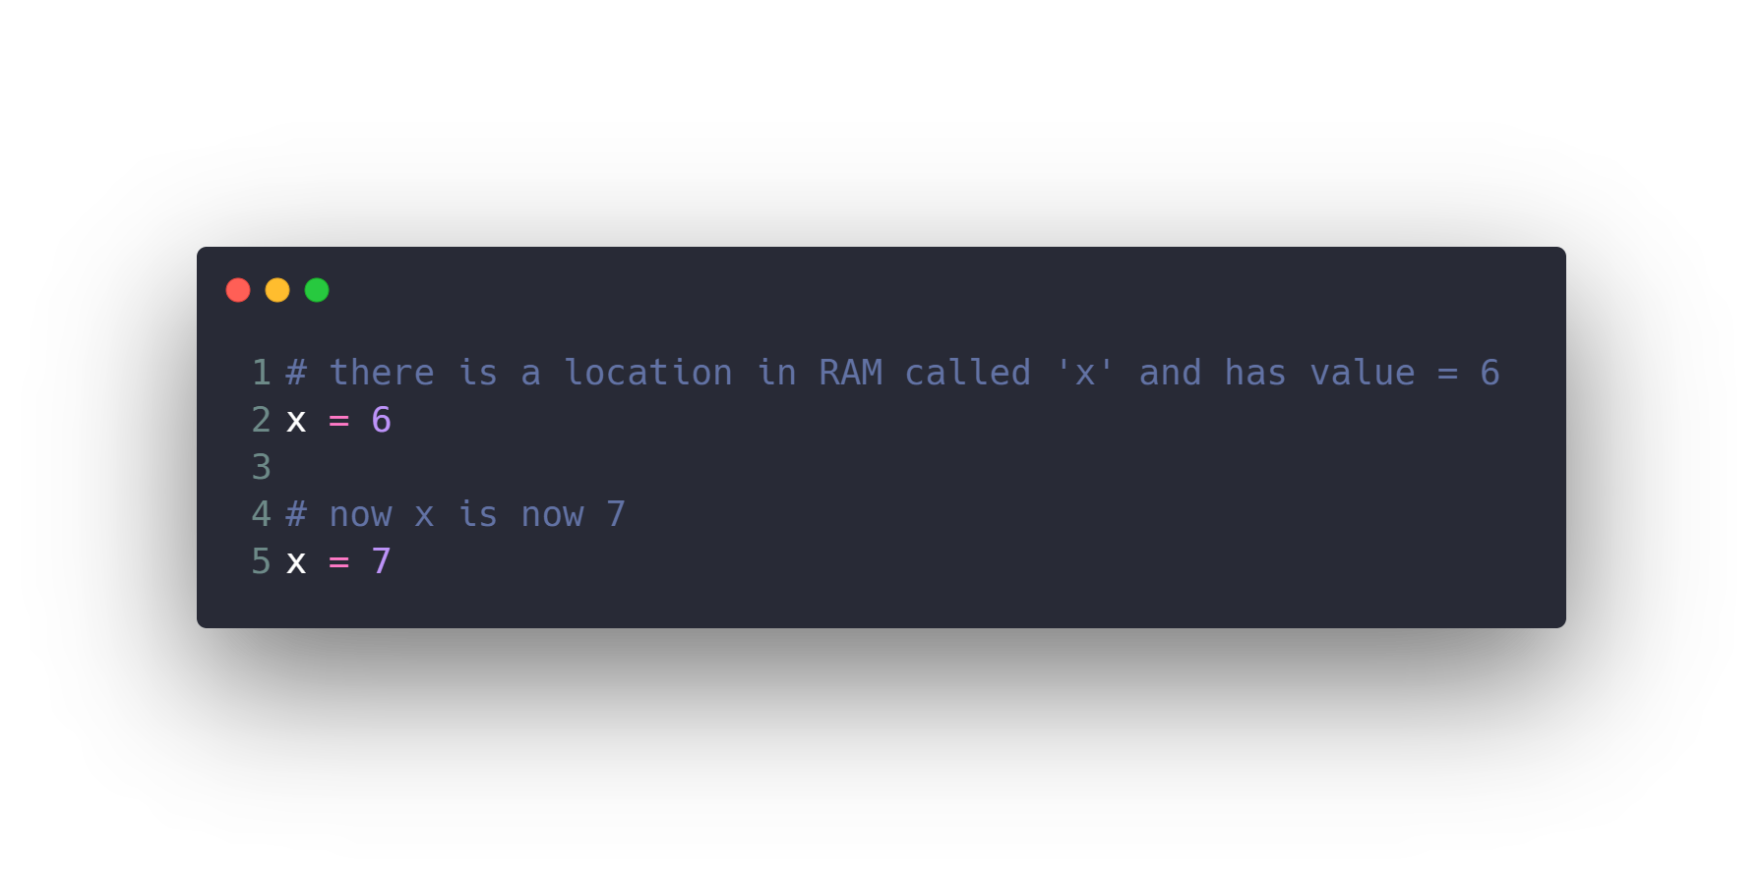
Variables

Slide 11
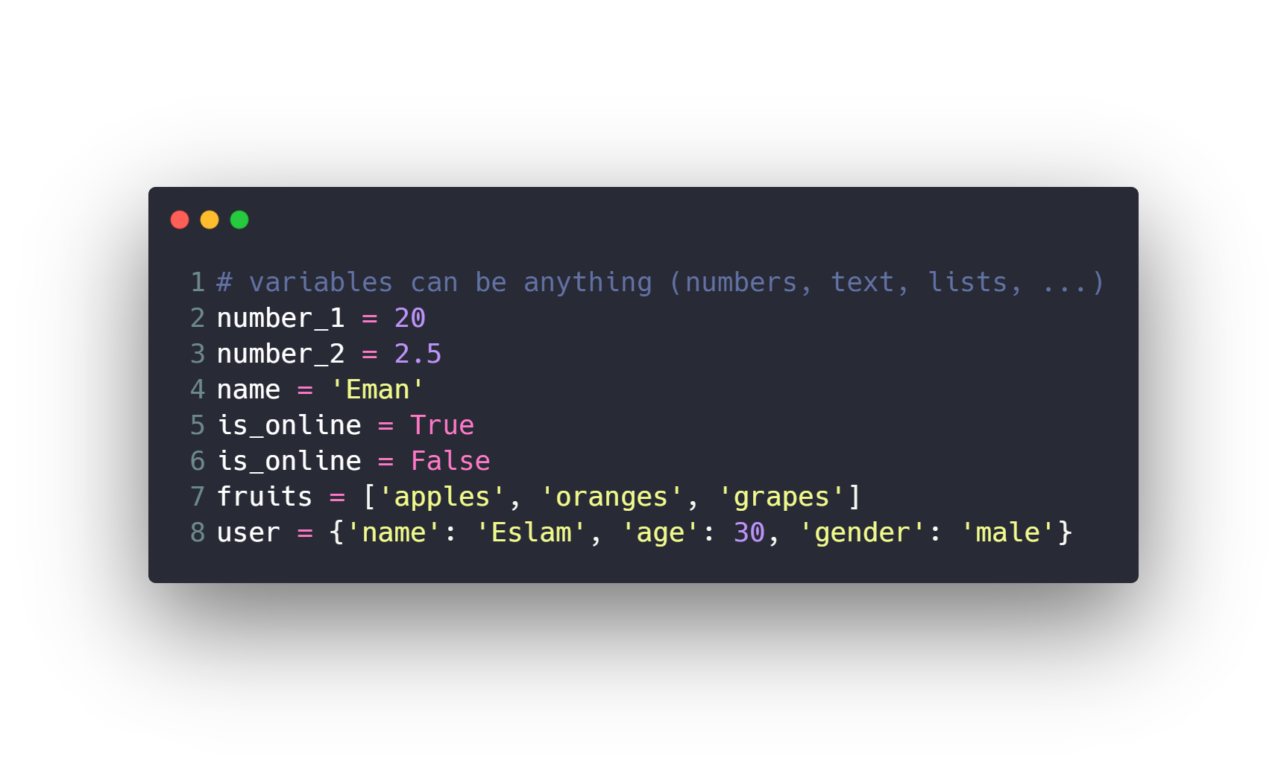
Variables

Slide 12
Variables
Rules for variables assignment
Names cannot start with numbers.
There can be no spaces, use _ instead.
Can’t use these symbols :”’<>/?|\()!@#$%^&*~-+=[],.
Avoid using words that have special meaning in Python like list.
For best practice user lowercase letters.
Use easy and meaningful name and related to the problem.

Slide 13
Introduction to Python programming Course Outline
Intro to Computer Science
Environment Setup (Anaconda)
Command Line
Conda & pip package managers
Jupyter Notebook
Input & Output
Variables
Data types
Numbers & Math
Boolean & Comparison and Logic
Strings
Lists
Tuples
Sets
Dictionaries
File Handling
If Conditions
For Loops
Built-in functions & Operators (zip, enumerate, range, …)
List Comprehensions
Functions
Lambda Expressions
Map, Filter, Reduce
Variables Scope
Modules & Packages

Slide 14
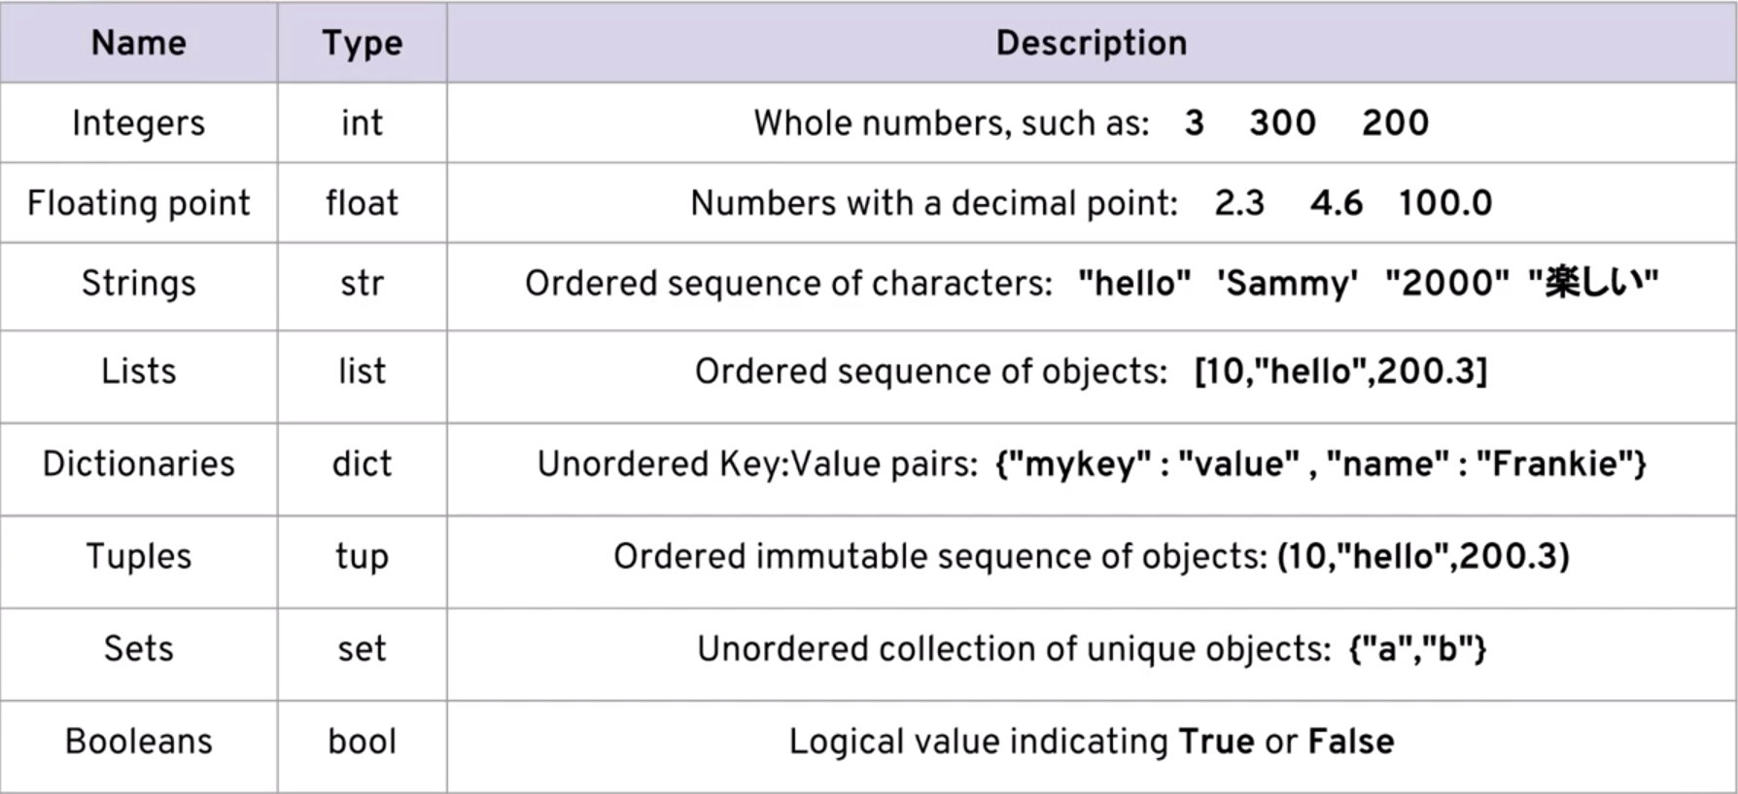
Data types

Slide 15
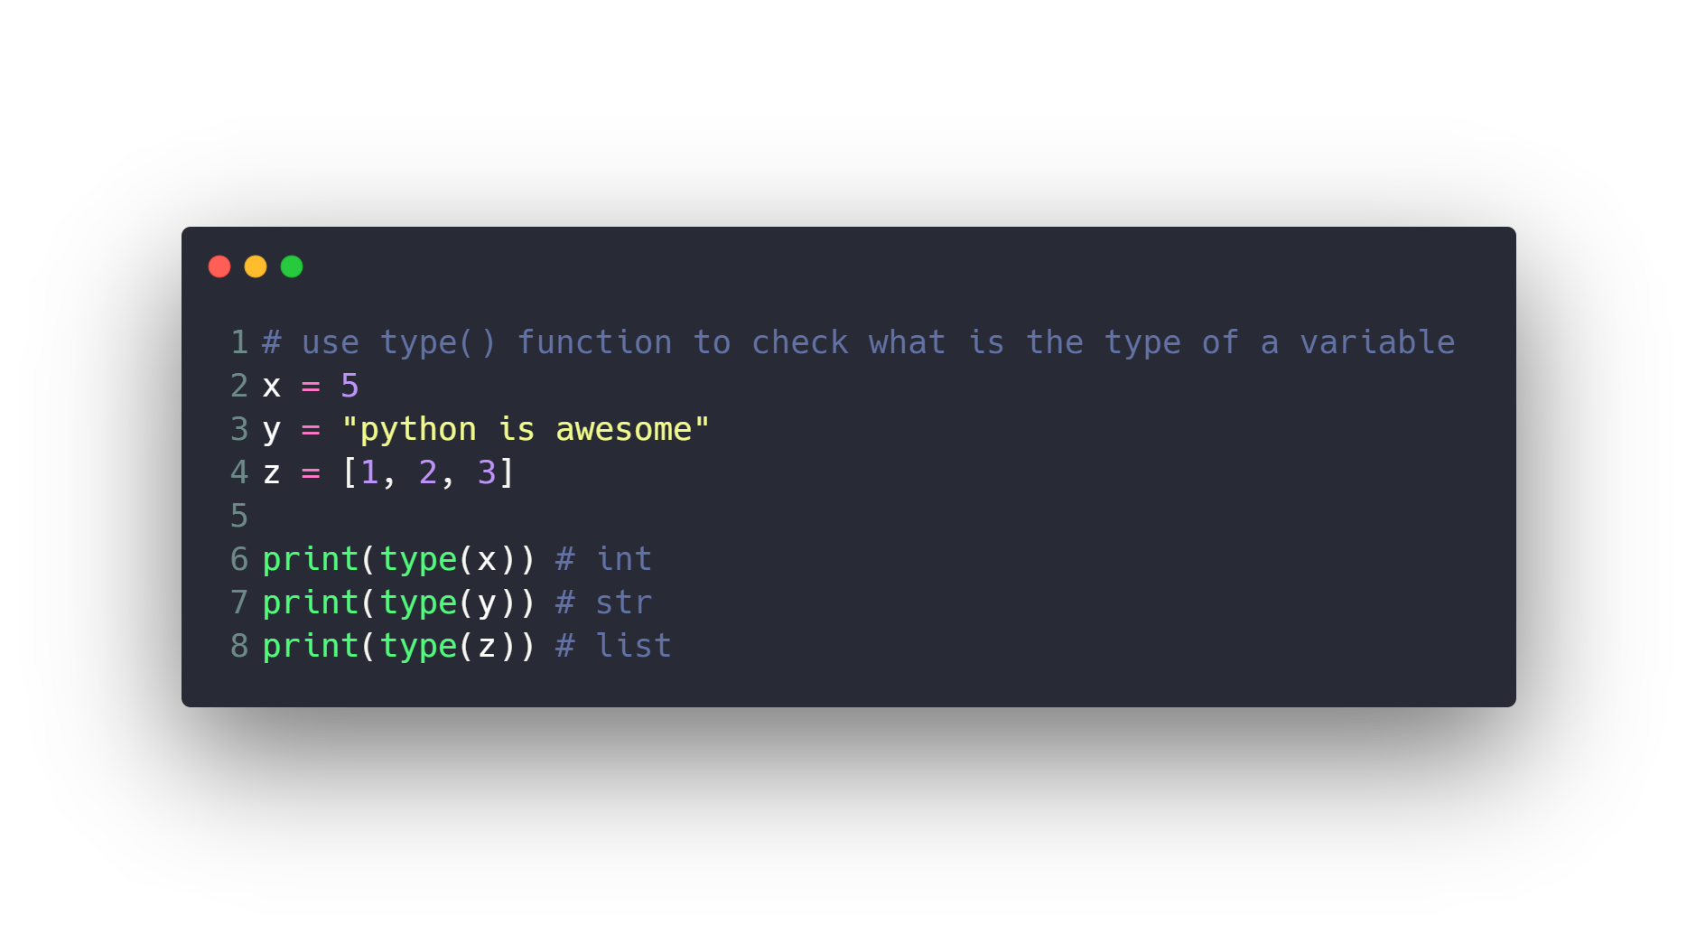
Data types

Slide 16
Introduction to Python programming Course Outline
Intro to Computer Science
Environment Setup (Anaconda)
Command Line
Conda & pip package managers
Jupyter Notebook
Input & Output
Variables
Data types
Numbers & Math
Boolean & Comparison and Logic
Strings
Lists
Tuples
Sets
Dictionaries
File Handling
If Conditions
For Loops
Built-in functions & Operators (zip, enumerate, range, …)
List Comprehensions
Functions
Lambda Expressions
Map, Filter, Reduce
Variables Scope
Modules & Packages

Slide 17
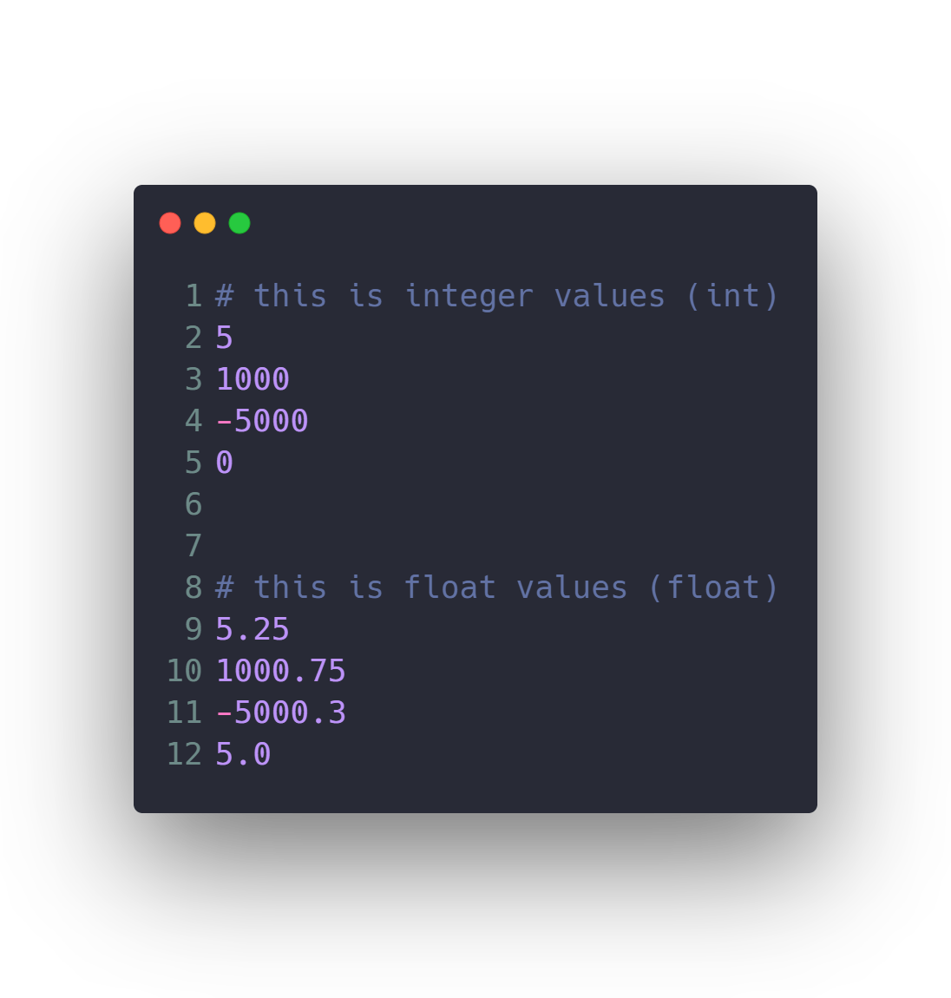
Numbers & Math

Slide 18
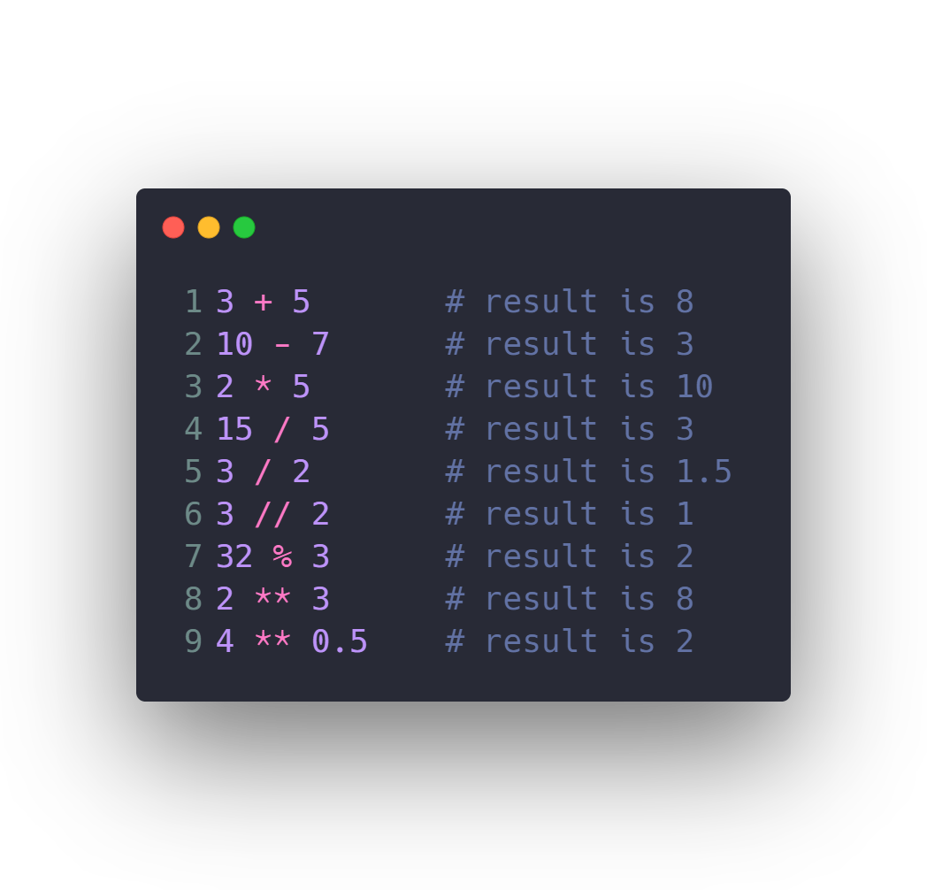
Numbers & Math

Slide 19
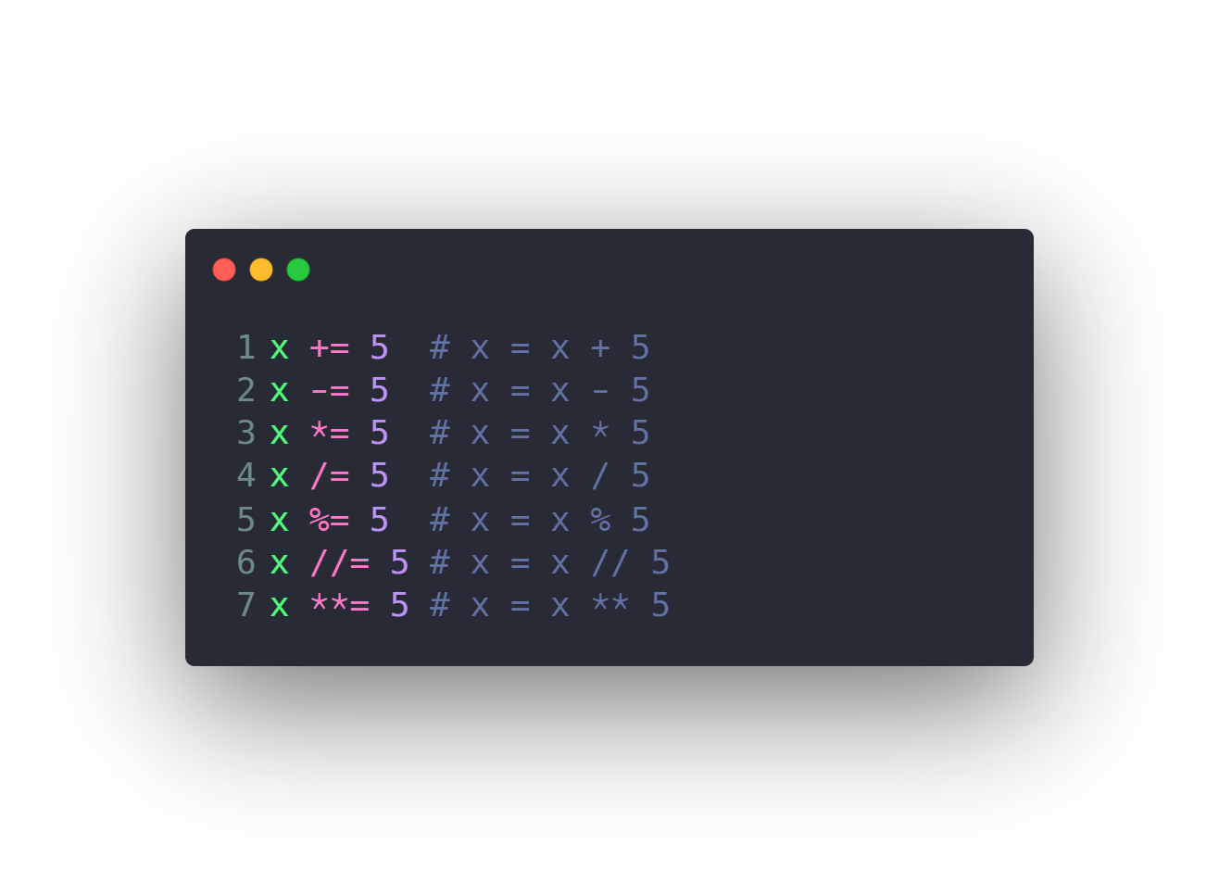
Numbers & Math

Slide 20
Introduction to Python programming Course Outline
Intro to Computer Science
Environment Setup (Anaconda)
Command Line
Conda & pip package managers
Jupyter Notebook
Input & Output
Variables
Data types
Numbers & Math
Boolean & Comparison and Logic
Strings
Lists
Tuples
Sets
Dictionaries
File Handling
If Conditions
For Loops
Built-in functions & Operators (zip, enumerate, range, …)
List Comprehensions
Functions
Lambda Expressions
Map, Filter, Reduce
Variables Scope
Modules & Packages

Slide 21
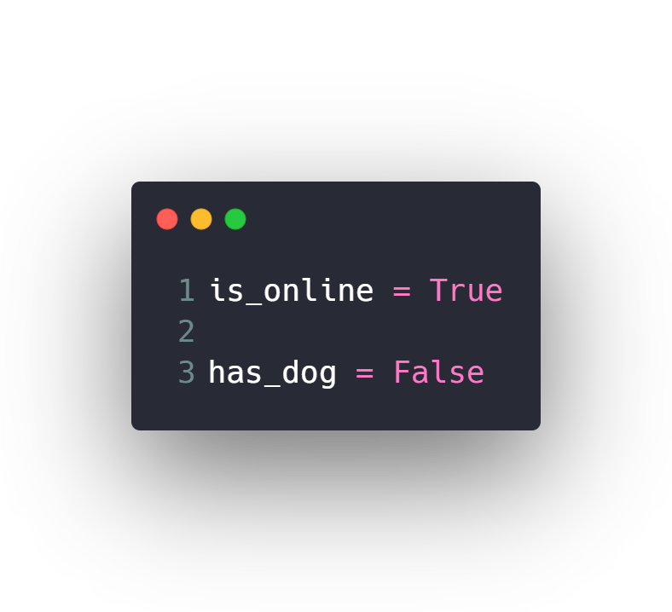
Boolean & Comparison and Logic

Slide 22
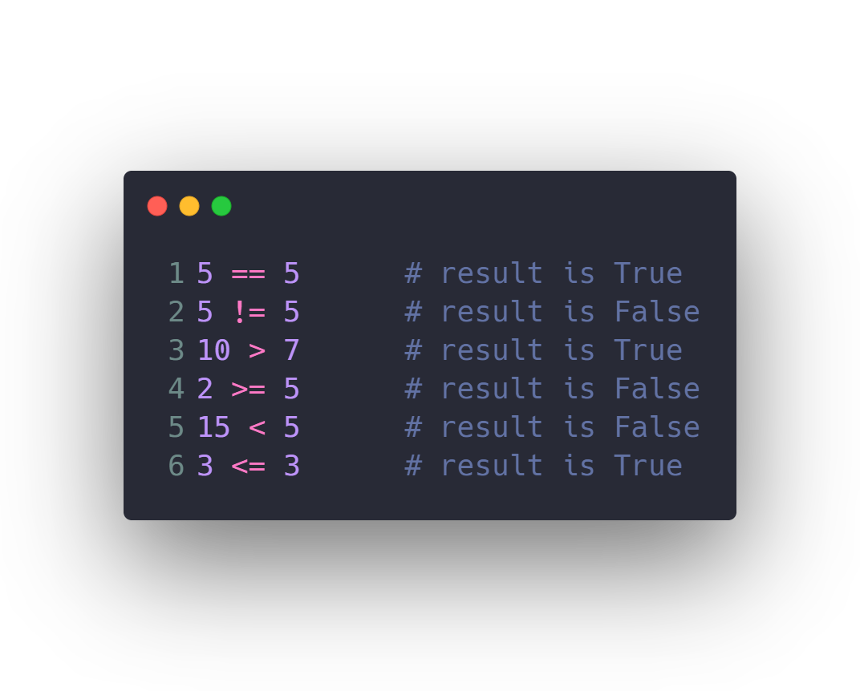
Boolean & Comparison and Logic

Slide 23
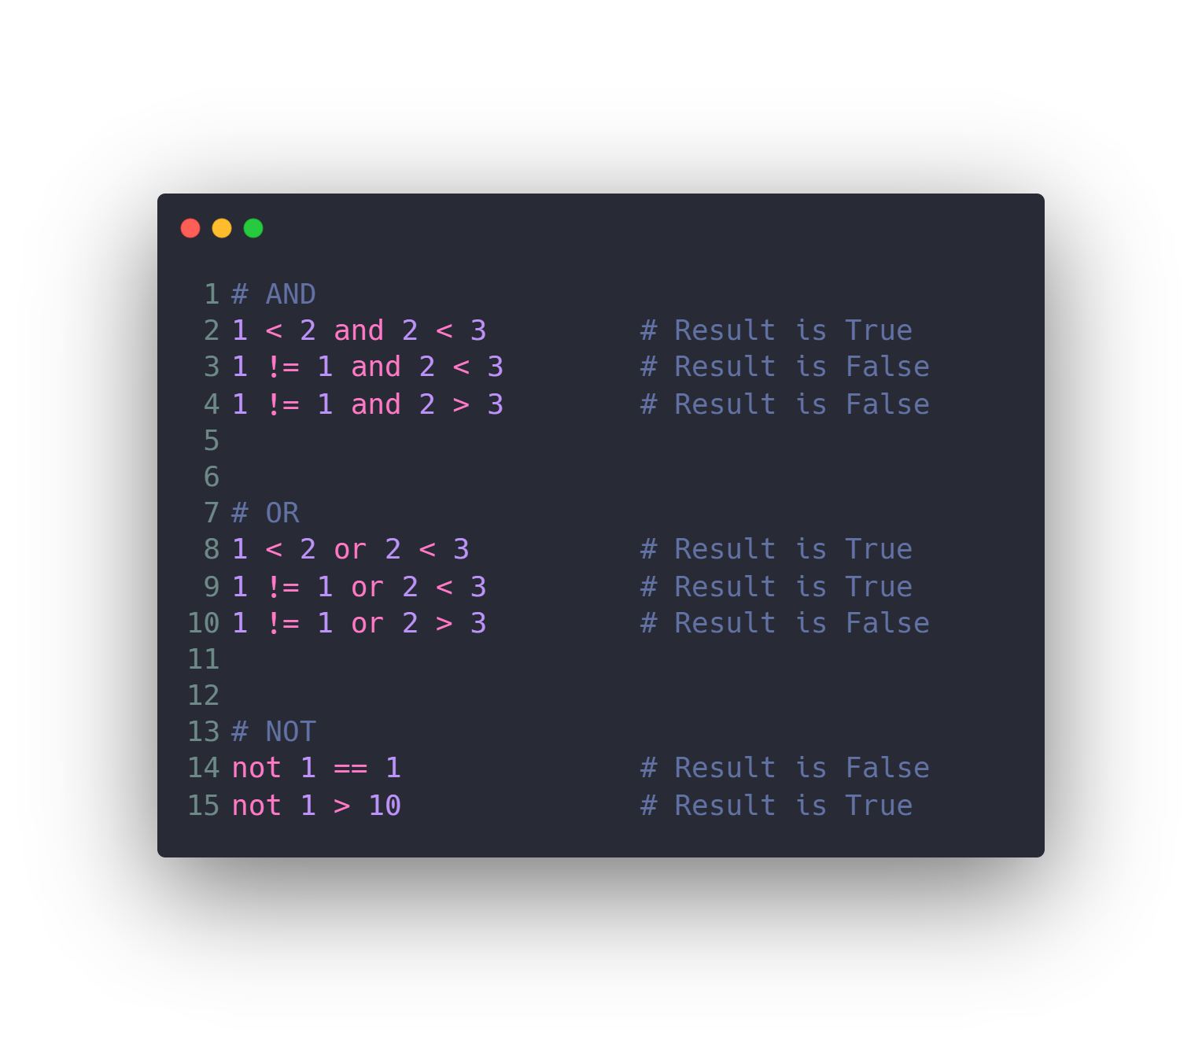
Boolean & Comparison and Logic

Slide 24
Introduction to Python programming Course Outline
Intro to Computer Science
Environment Setup (Anaconda)
Command Line
Conda & pip package managers
Jupyter Notebook
Input & Output
Variables
Data types
Numbers & Math
Boolean & Comparison and Logic
Strings
Lists
Tuples
Sets
Dictionaries
File Handling
If Conditions
For Loops
Built-in functions & Operators (zip, enumerate, range, …)
List Comprehensions
Functions
Lambda Expressions
Map, Filter, Reduce
Variables Scope
Modules & Packages

Slide 25
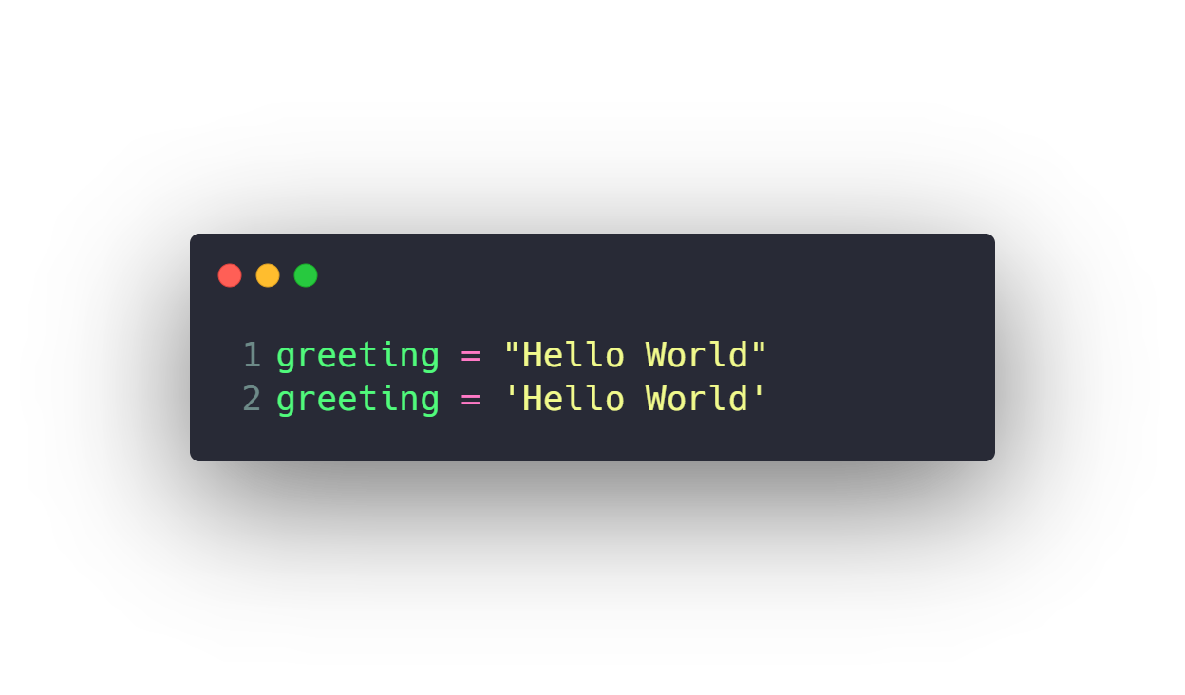
Strings

Slide 26
Introduction to Python programming Course Outline
Intro to Computer Science
Environment Setup (Anaconda)
Command Line
Conda & pip package managers
Jupyter Notebook
Input & Output
Variables
Data types
Numbers & Math
Boolean & Comparison and Logic
Strings
Lists
Tuples
Sets
Dictionaries
File Handling
If Conditions
For Loops
Built-in functions & Operators (zip, enumerate, range, …)
List Comprehensions
Functions
Lambda Expressions
Map, Filter, Reduce
Variables Scope
Modules & Packages

Slide 27
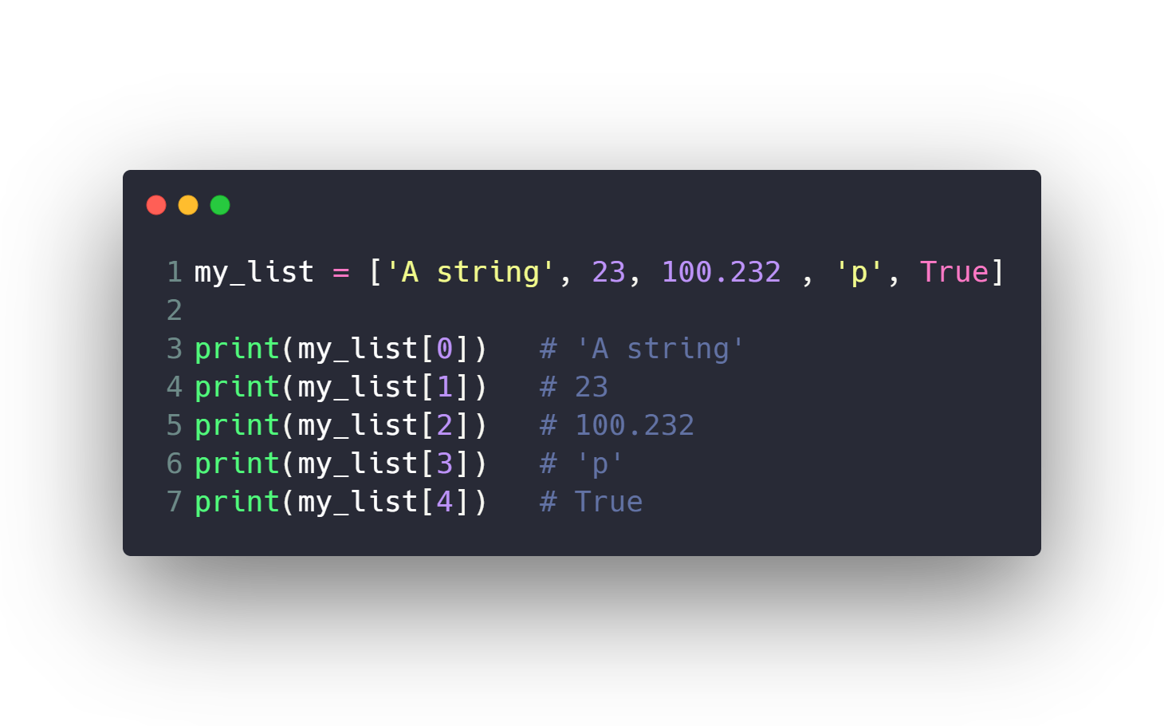
Lists

Slide 28
Introduction to Python programming Course Outline
Intro to Computer Science
Environment Setup (Anaconda)
Command Line
Conda & pip package managers
Jupyter Notebook
Input & Output
Variables
Data types
Numbers & Math
Boolean & Comparison and Logic
Strings
Lists
Tuples
Sets
Dictionaries
File Handling
If Conditions
For Loops
Built-in functions & Operators (zip, enumerate, range, …)
List Comprehensions
Functions
Lambda Expressions
Map, Filter, Reduce
Variables Scope
Modules & Packages

Slide 29
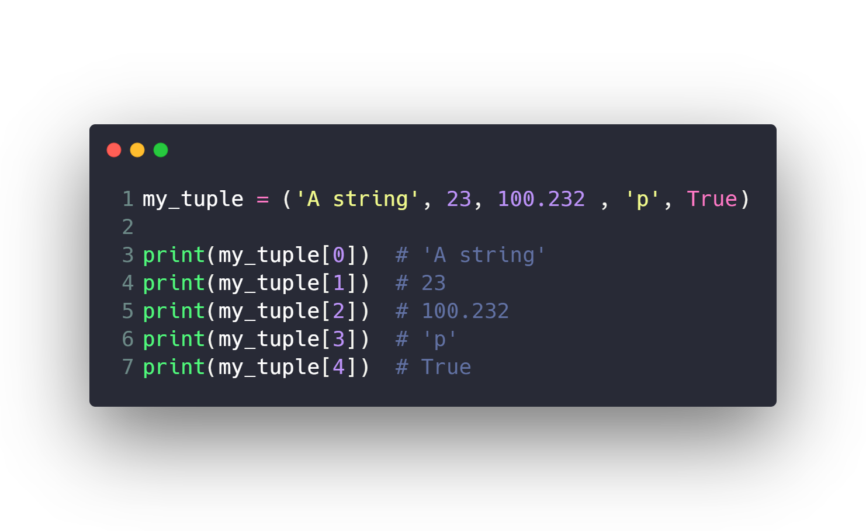
Tuples (faster and immutable lists)
Used when you have immutable values and need faster processing on them

Slide 30
Introduction to Python programming Course Outline
Intro to Computer Science
Environment Setup (Anaconda)
Command Line
Conda & pip package managers
Jupyter Notebook
Input & Output
Variables
Data types
Numbers & Math
Boolean & Comparison and Logic
Strings
Lists
Tuples
Sets
Dictionaries
File Handling
If Conditions
For Loops
Built-in functions & Operators (zip, enumerate, range, …)
List Comprehensions
Functions
Lambda Expressions
Map, Filter, Reduce
Variables Scope
Modules & Packages

Slide 31
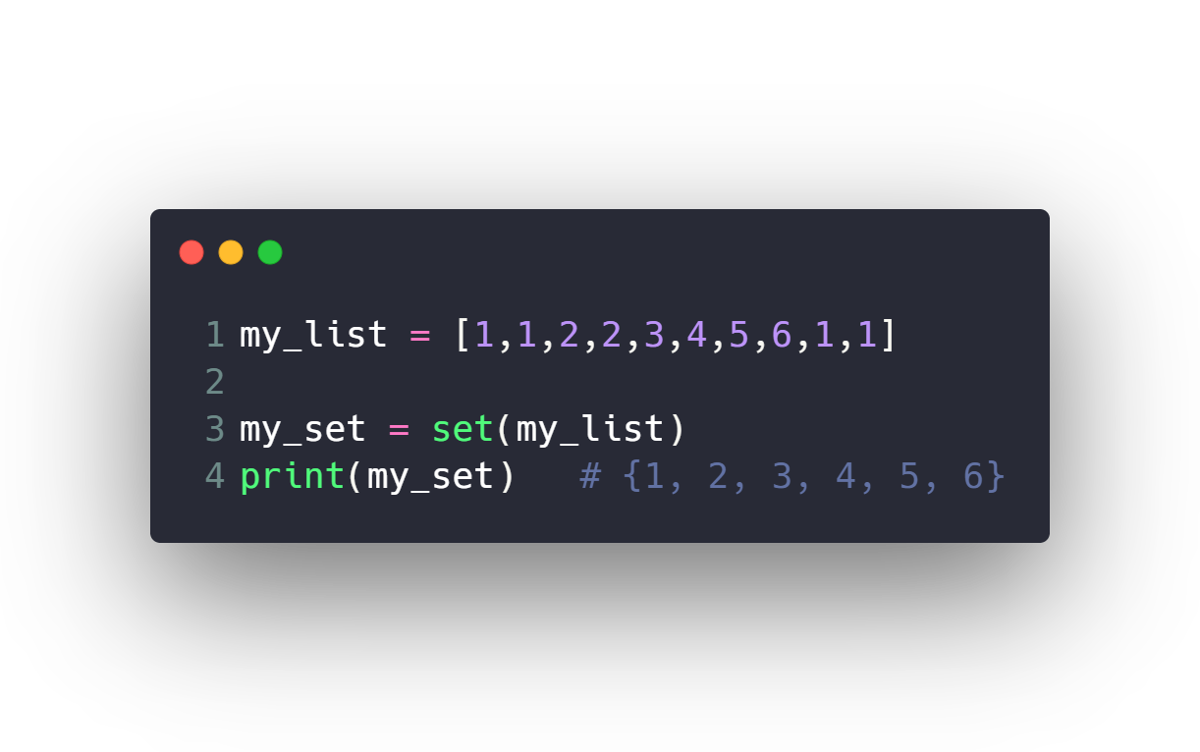
Sets (unique lists)
Used for intersections & union operations

Slide 32
Introduction to Python programming Course Outline
Intro to Computer Science
Environment Setup (Anaconda)
Command Line
Conda & pip package managers
Jupyter Notebook
Input & Output
Variables
Data types
Numbers & Math
Boolean & Comparison and Logic
Strings
Lists
Tuples
Sets
Dictionaries
File Handling
If Conditions
For Loops
Built-in functions & Operators (zip, enumerate, range, …)
List Comprehensions
Functions
Lambda Expressions
Map, Filter, Reduce
Variables Scope
Modules & Packages

Slide 33
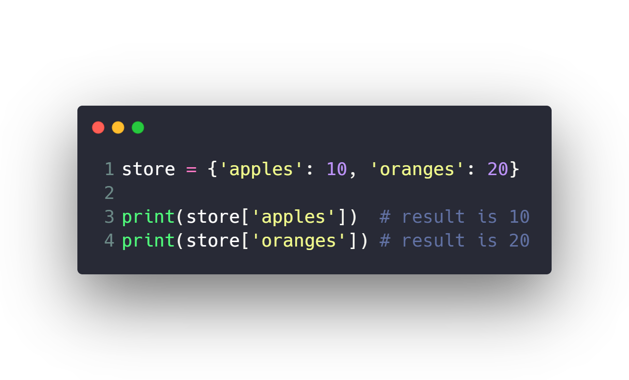
Dictionaries

Slide 34
Introduction to Python programming Course Outline
Intro to Computer Science
Environment Setup (Anaconda)
Command Line
Conda & pip package managers
Jupyter Notebook
Input & Output
Variables
Data types
Numbers & Math
Boolean & Comparison and Logic
Strings
Lists
Tuples
Sets
Dictionaries
File Handling
If Conditions
For Loops
Built-in functions & Operators (zip, enumerate, range, …)
List Comprehensions
Functions
Lambda Expressions
Map, Filter, Reduce
Variables Scope
Modules & Packages

Slide 35
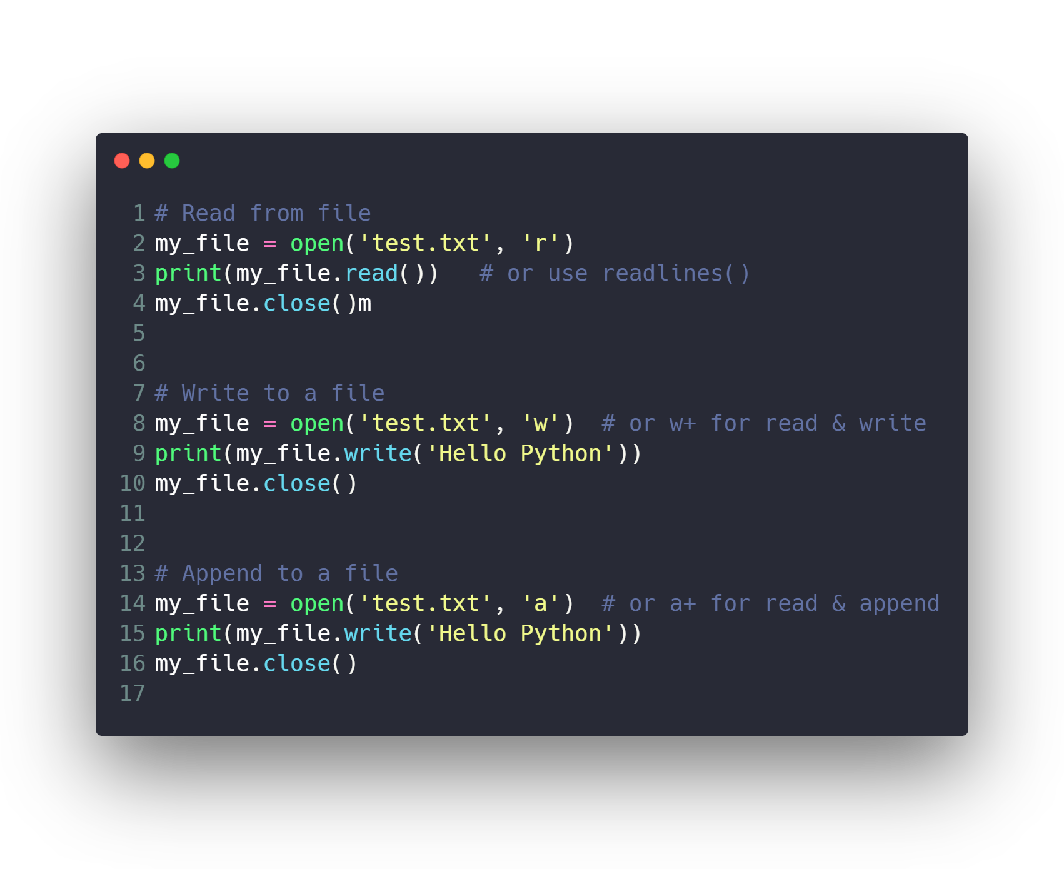
File Handling

Slide 36
Introduction to Python programming Course Outline
Intro to Computer Science
Environment Setup (Anaconda)
Command Line
Conda & pip package managers
Jupyter Notebook
Input & Output
Variables
Data types
Numbers & Math
Boolean & Comparison and Logic
Strings
Lists
Tuples
Sets
Dictionaries
File Handling
If Conditions
For Loops
Built-in functions & Operators (zip, enumerate, range, …)
List Comprehensions
Functions
Lambda Expressions
Map, Filter, Reduce
Variables Scope
Modules & Packages

Slide 37
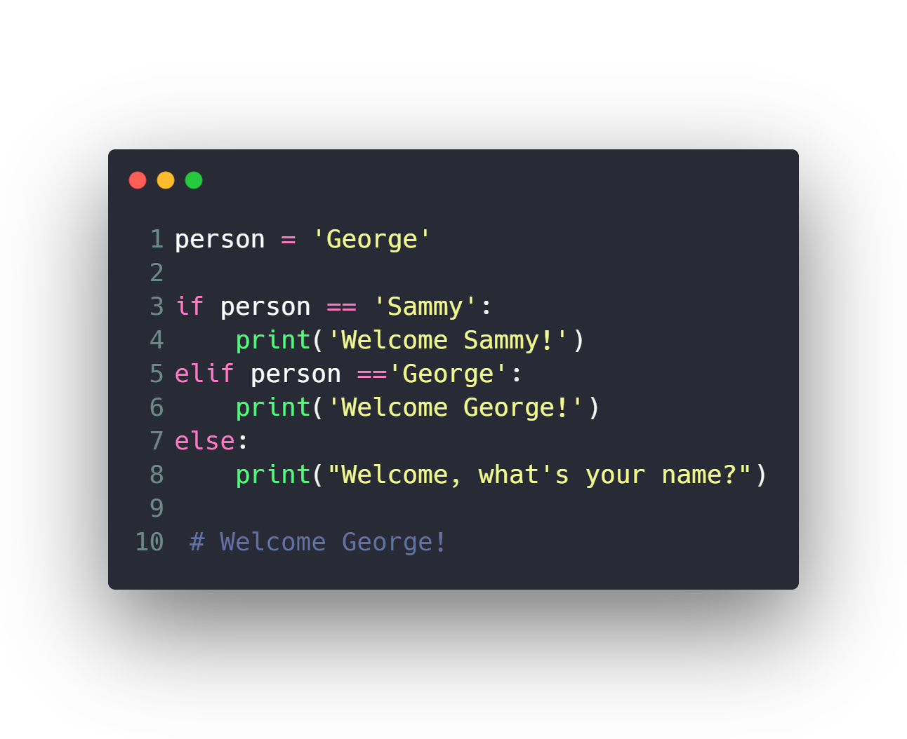
If Conditions

Slide 38
Introduction to Python programming Course Outline
Intro to Computer Science
Environment Setup (Anaconda)
Command Line
Conda & pip package managers
Jupyter Notebook
Input & Output
Variables
Data types
Numbers & Math
Boolean & Comparison and Logic
Strings
Lists
Tuples
Sets
Dictionaries
File Handling
If Conditions
For Loops
Built-in functions & Operators (zip, enumerate, range, …)
List Comprehensions
Functions
Lambda Expressions
Map, Filter, Reduce
Variables Scope
Modules & Packages

Slide 39
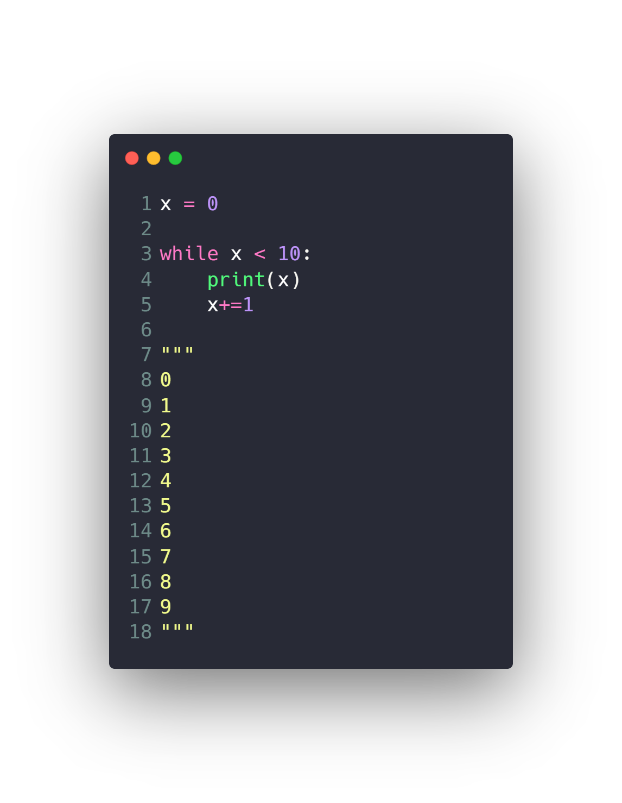
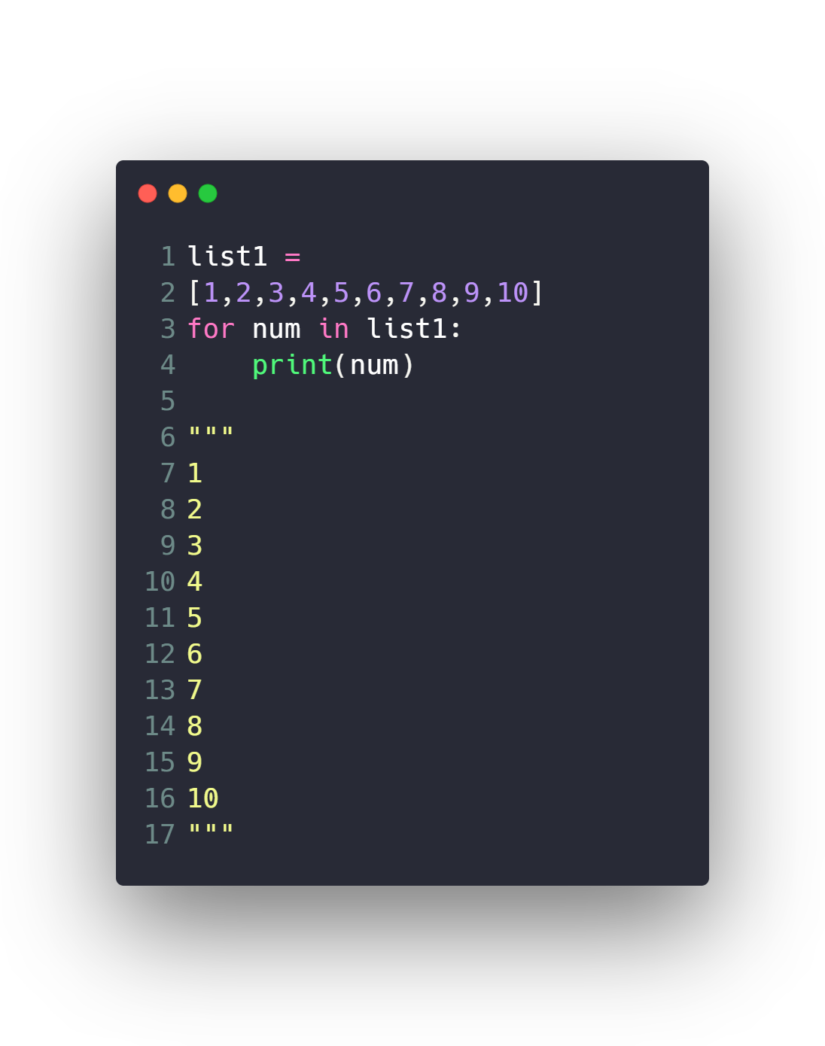
For Loops
While Loops

Slide 40
Introduction to Python programming Course Outline
Intro to Computer Science
Environment Setup (Anaconda)
Command Line
Conda & pip package managers
Jupyter Notebook
Input & Output
Variables
Data types
Numbers & Math
Boolean & Comparison and Logic
Strings
Lists
Tuples
Sets
Dictionaries
File Handling
If Conditions
For Loops
Built-in functions & Operators (zip, enumerate, range, …)
List Comprehensions
Functions
Lambda Expressions
Map, Filter, Reduce
Variables Scope
Modules & Packages

Slide 41
Built-in functions & Operators
Range
Enumerate
Zip
In
Sorted
Min & max and abs
…

Slide 42
Introduction to Python programming Course Outline
Intro to Computer Science
Environment Setup (Anaconda)
Command Line
Conda & pip package managers
Jupyter Notebook
Input & Output
Variables
Data types
Numbers & Math
Boolean & Comparison and Logic
Strings
Lists
Tuples
Sets
Dictionaries
File Handling
If Conditions
For Loops
Built-in functions & Operators (zip, enumerate, range, …)
List Comprehensions
Functions
Lambda Expressions
Map, Filter, Reduce
Variables Scope
Modules & Packages

Slide 43
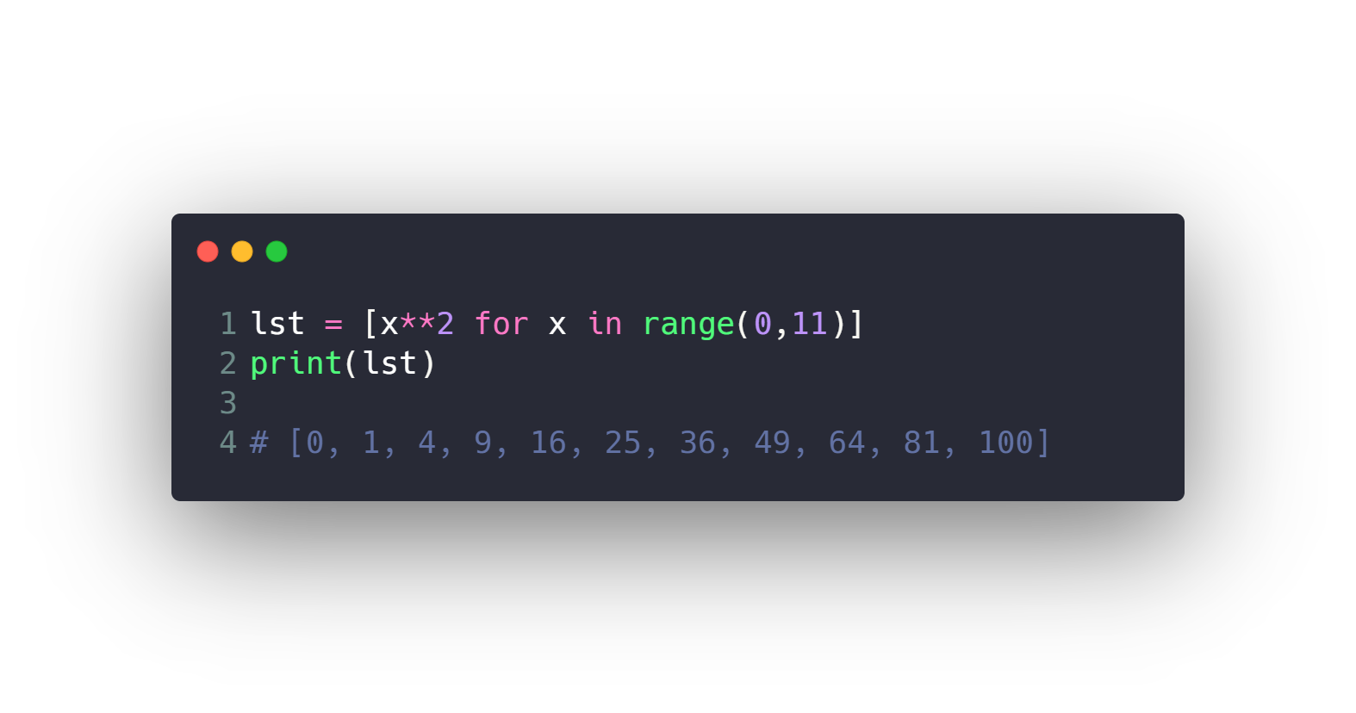
List Comprehensions

Slide 44
Introduction to Python programming Course Outline
Intro to Computer Science
Environment Setup (Anaconda)
Command Line
Conda & pip package managers
Jupyter Notebook
Input & Output
Variables
Data types
Numbers & Math
Boolean & Comparison and Logic
Strings
Lists
Tuples
Sets
Dictionaries
File Handling
If Conditions
For Loops
Built-in functions & Operators (zip, enumerate, range, …)
List Comprehensions
Functions
Lambda Expressions
Map, Filter, Reduce
Variables Scope
Modules & Packages

Slide 45
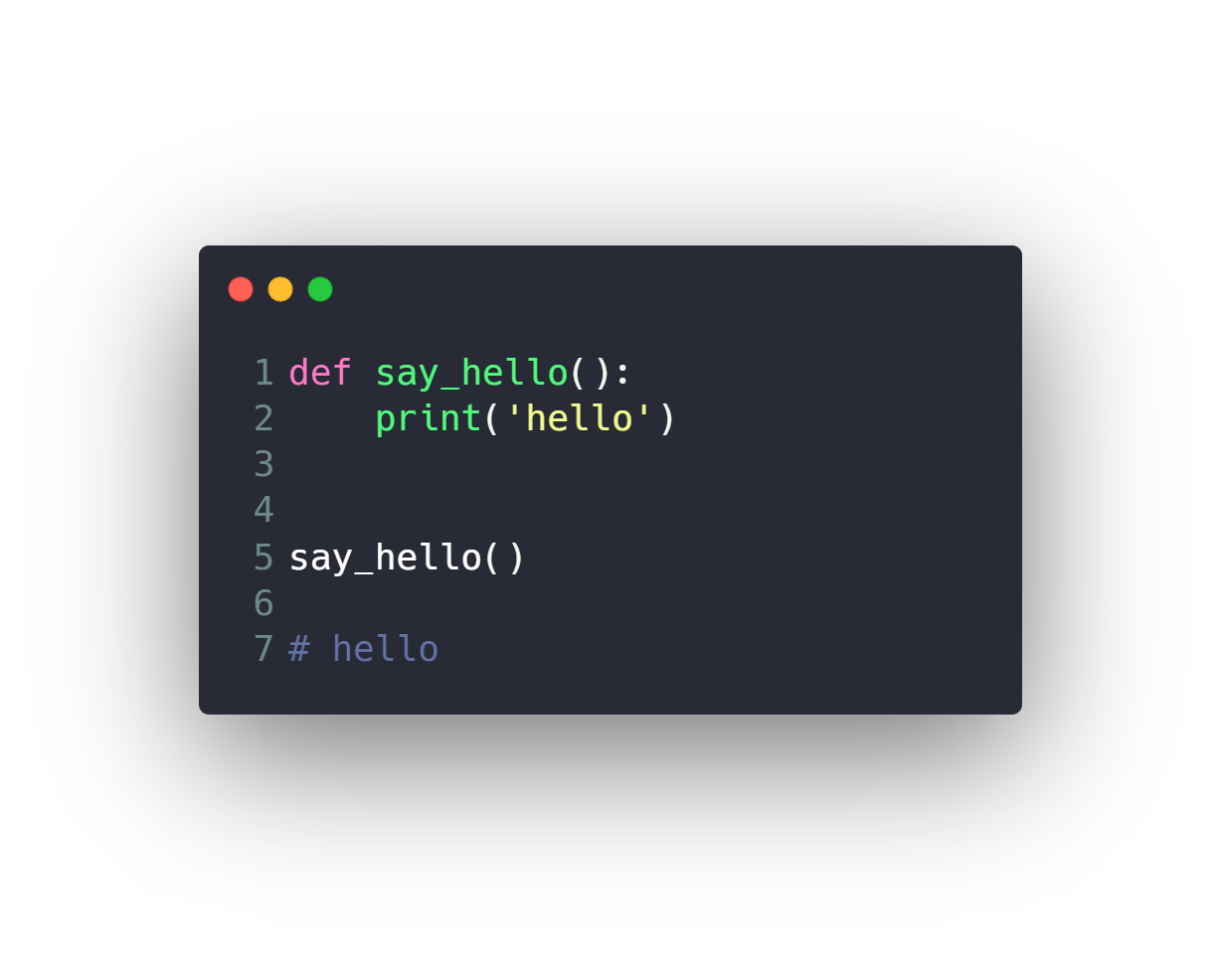
Functions

Slide 46
Introduction to Python programming Course Outline
Intro to Computer Science
Environment Setup (Anaconda)
Command Line
Conda & pip package managers
Jupyter Notebook
Input & Output
Variables
Data types
Numbers & Math
Boolean & Comparison and Logic
Strings
Lists
Tuples
Sets
Dictionaries
File Handling
If Conditions
For Loops
Built-in functions & Operators (zip, enumerate, range, …)
List Comprehensions
Functions
Lambda Expressions
Map, Filter, Reduce
Variables Scope
Modules & Packages

Slide 47
Lambda Expressions & Map, Filter, Reduce
Map
Filter
Reduce
Lambda Expression

Slide 48
Introduction to Python programming Course Outline
Intro to Computer Science
Environment Setup (Anaconda)
Command Line
Conda & pip package managers
Jupyter Notebook
Input & Output
Variables
Data types
Numbers & Math
Boolean & Comparison and Logic
Strings
Lists
Tuples
Sets
Dictionaries
File Handling
If Conditions
For Loops
Built-in functions & Operators (zip, enumerate, range, …)
List Comprehensions
Functions
Lambda Expressions
Map, Filter, Reduce
Variables Scope
Modules & Packages

Slide 49
Variables Scope
Local
Global

Slide 50
Introduction to Python programming Course Outline
Intro to Computer Science
Environment Setup (Anaconda)
Command Line
Conda & pip package managers
Jupyter Notebook
Input & Output
Variables
Data types
Numbers & Math
Boolean & Comparison and Logic
Strings
Lists
Tuples
Sets
Dictionaries
File Handling
If Conditions
For Loops
Built-in functions & Operators (zip, enumerate, range, …)
List Comprehensions
Functions
Lambda Expressions
Map, Filter, Reduce
Variables Scope
Modules & Packages

Slide 51
Modules & Packages
Module is a file which contains various Python functions and global variables. It is simply just .py extension file which has python executable code.
Package is a collection of modules.
Library is a collection of packages.
Framework is a collection of libraries.

Slide 52
Modules & Packages
Random
OS
Datetime
Install external code
How to make your custom module
How to make your custom package

Slide 53
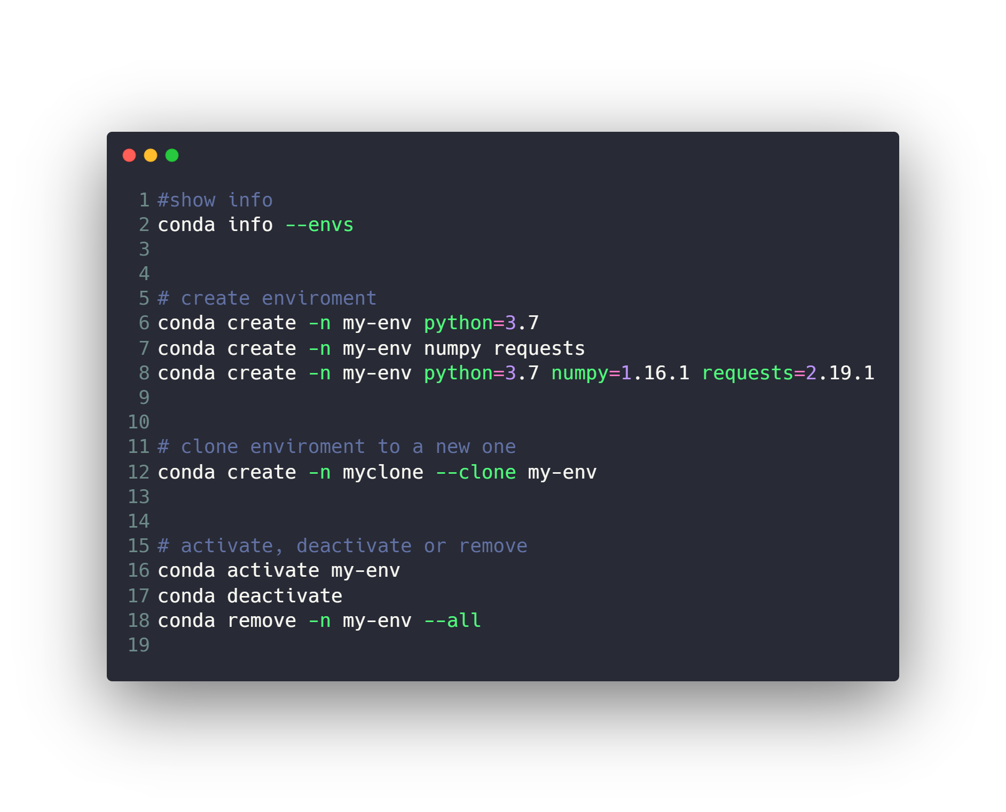
Conda enviroments
Don’t forget to add jupyter kernel for this newly created enviroment
https://janakiev.com/blog/jupyter-virtual-envs/

Slide 54
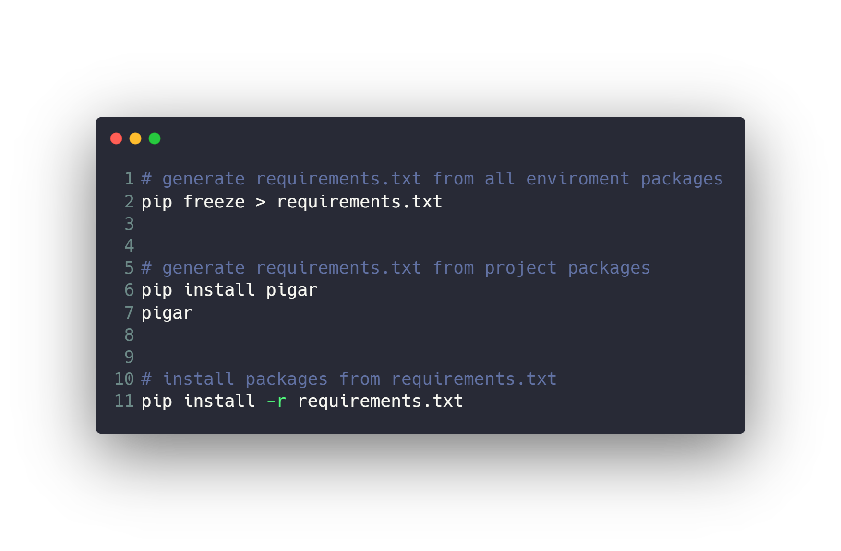
Conda enviroments

Slide 55

Time for Thanos.py >_

Slide 56
Questions ?!

Slide 57

Thanks! >_ Live long and prosper

